Slide 1

Watt-hour Meter OCR
By Jad sakr
Notes:
Hello, I’m Jad sakr, a computer science major student at the lebanese american university. I will be presenting today my final year project “ A watt-hour meter ocr”

Slide 2
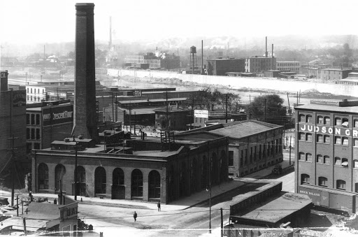
Background
In 1878 Thomas Edison founded the Edison Electric Light Co. (US), in New York City.
The company could support up to 5000 bulbs at the time.
Notes:
First let’s start with a little background about the beginning of electricity.
In 1878 Thomas Edison, after creating the light bulb, founded the Edison Electric Light Co. (US), in New York City.
The company could support up to 5000 bulbs at the time.

Slide 3
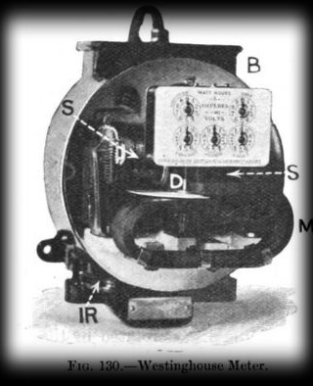
Electric Bill Collection
Consumption in Kilowatt
Price of one Kilowatt specified by the company
The Kilowatt meter helps in counting the amount of Kilowatt consumed.
Multiply the Kilowatt time by the rate of the company to get the final bill
Notes:
The picture shown here, is a picture of a Kilowatt-hour meter in 1878.
Consumption is measured in Kilowatt
Price of one Kilowatt was specified by the company
The Kilowatt meter helps in counting the amount of Kilowatt consumed.
Multiply the Kilowatt time by the rate of the company to get the final bill

Slide 4
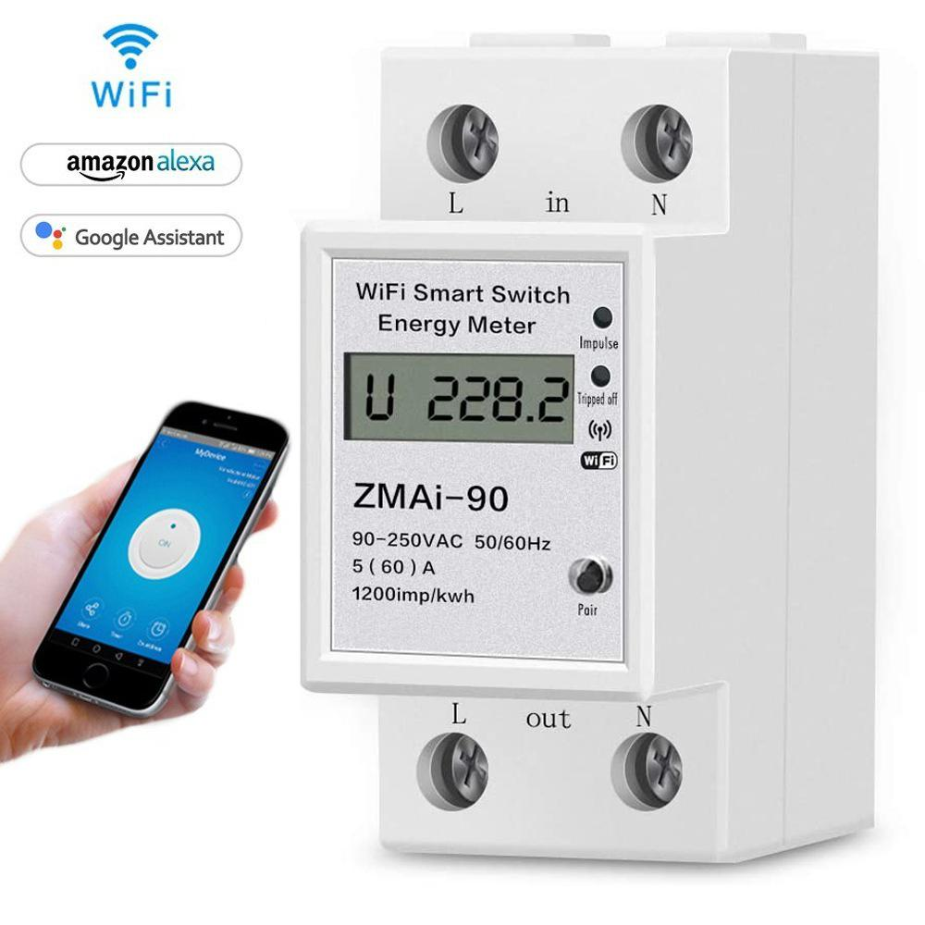
Advanced Watt-hour Meters
Advantages:
Connected to wifi
Monitor everyday consumption
Bill monitoring
Notes:
Nowadays, anyone can buy a smart watt-hour meter. This meter has to be connected to the wifi. Read the slides.
In more advanced way, these meters can be designed specifically to one company and connected to a database to store the consumption automatically at the end of each month.

Slide 5
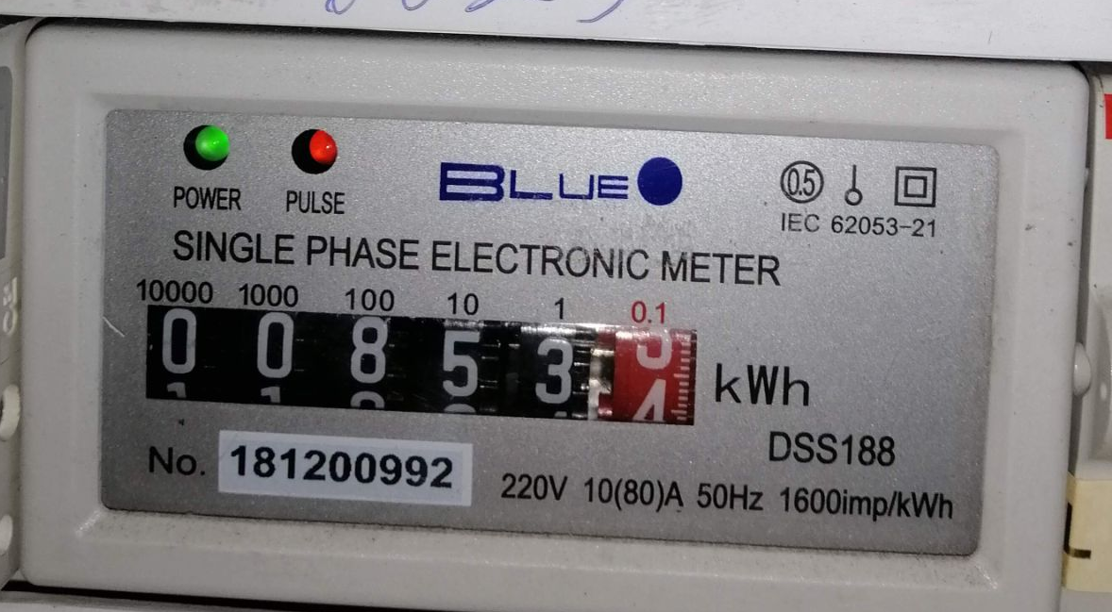
📍Lebanon
Notes:
This is the meter that is available in nearly all the lebanese houses. Note that this not a smart meter and it requires an in-person check up each month for billing.

Slide 6


Billing Methodology in Lebanon
1 Person
1,200 bill
Notes:
According to an owner of the private generators in Jbeil Lebanon. 1 person can handle a maximum of 1200 bills.

Slide 7



The Process
12 Days:
Last month bill collection
24 Days of work
12 Days:
Current Month Watt meter collection
Notes:
Considering that there is 24 working days a month in Lebanon. And based on the input of one of my relatives who works for one of the private electricity suppliers. They dedicate 12 days of the month for collecting the bills of the month before and the other 12 days to collect the KiloWatt hours consumed for each of these 1200 households.

Slide 8


Collecting the watt-hour meter
Taking a photo of every Watt-hour meter
That is a total of 1200 images
Without google photos - extra disk space
7 days
5 days
At home, write down the 6 digits of every Watt-hour Meter on a hard copy of an excel sheet.
Notes:
The process of collecting the the watt-hour meter consumptions, consists of two phases: one, taking the photo of every meter, Second write down each one of them on a sheet of paper

Slide 9
My project purpose
Make the collection of the the Watt-hour Meters easier.
Minimizing the amount of time to finish this process.
Help monitor the progress in real-time.
The Idea
Create a mobile application to scan the image
Read the image using an OCR
Append the result to the database
Check if any Watt-hour Meter was missed nearby

Slide 10
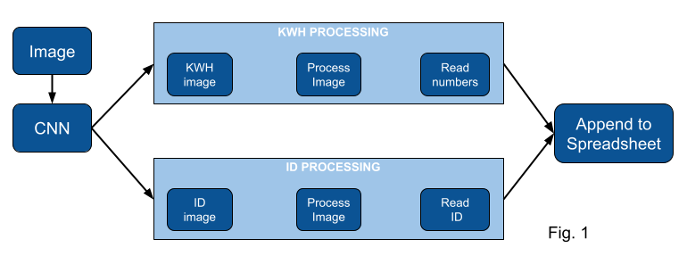
The Backend

Slide 11
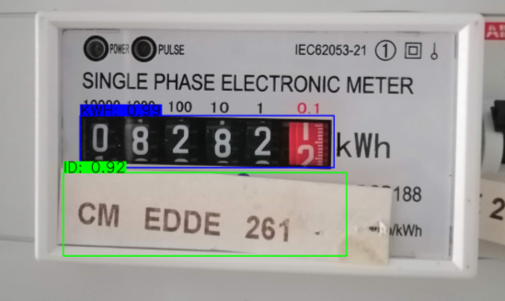
YoloV4 CNN
The CNN has the Darknet53 as an architecture
Notes:
First step is passing the image through the Convolutional neural network

Slide 12

Image Processing
GrayScale and Blur
Threshold using Otsu’s method
Closing Morphology
Adaptive thresholding
Cleaning
Notes:
Next we should process the image and extract the 6 digits out of it.
We will perform the following operation on this image
GrayScale and Blur: in order to remove the noise
Threshold using otsu’s method: To segment the image
Closing morphology: useful for filling small holes from an image while preserving the shape and size of the objects in the image
Adaptive Thresholding: Separates the glare from the digits
Cleaning the image: Remove all clusters of pixels with an area less 1% from the whole image

Slide 13







The resulting image
Find contours in the resulting image
Loop through each contour
Notes:
This is the resulting image from the operations done before. Now we can find the contours inside this image. Next we loop through each of these contours and we pick the ones with a size relatively big comparing to the size of the image. These are most probably our numbers.

Slide 14
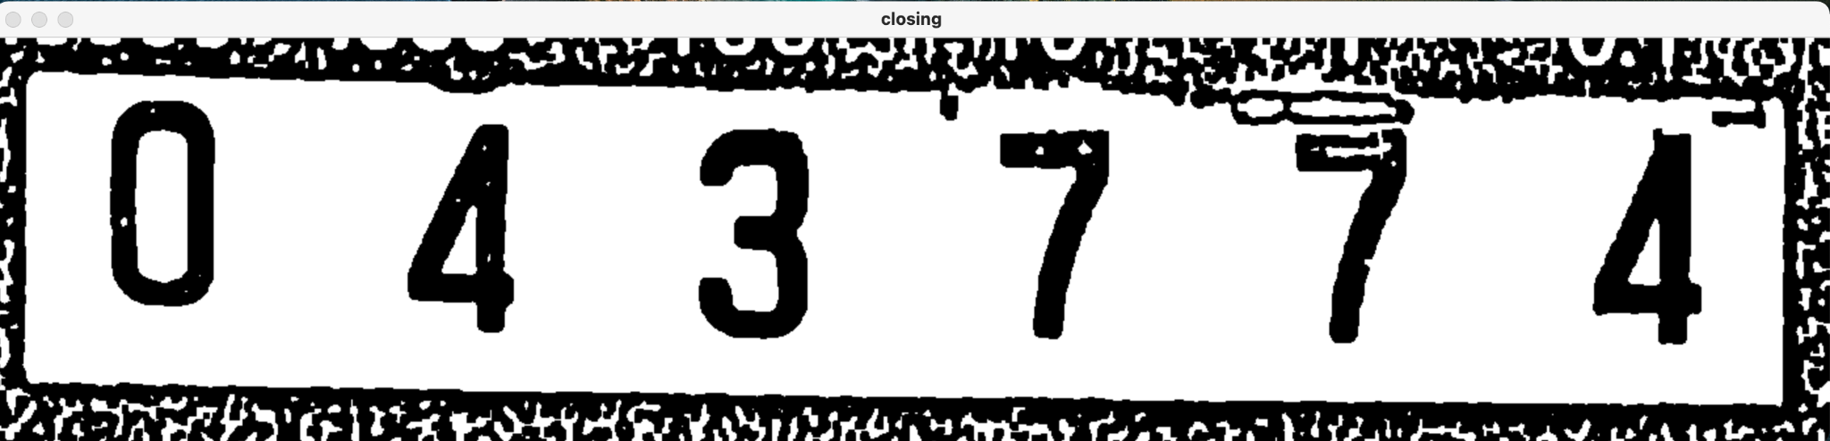
Cropping the image
Notes:
Now using the digits coordinates segmented before, we will crop the image to include only this 6 digit. Then read the 6 digits in one image at once.

Slide 15






Read the cropped image
The 6 digits read all together
Find the contours, read each digit alone
Notes:
Using the cropped image, we are going to have two additional outputs: one is the whole image read as it is. Two, finding the contours and reading each digit alone

Slide 16
Picking the final answer
X: | 0 | 200 | 400 | 600 | 800 | 1000
Dig | 0 | 4 | 3 | 7 | 1 | 4
X: | 0 | 200 | 400 | 600 | 800 | 1000
Dig | 0 | 4 | 8 | 7 | 7 | 4
X: | 0 | 200 | 400 | 600 | 800 | 1000
Dig | 0 | 4 | 3 | 7 | 7 | 6
Digit | 0 | 4 | 3 | 7 | 7 | 4
X: | 0 | 200 | 400 | 600 | 800 | 1000
Notes:
Now that we have 3 readings for each image, we can create a voting algorithm to pick the final answer

Slide 17
Picking the final answer
X: | 0 | 200 | 400 | 600 | 800 | 1000
Dig | 0 | 4 | 3 | 7 | 1 | 4
X: | 0 | 200 | 400 | 600 | 800 | 1000
Dig | 0 | 4 | 8 | 7 | 7 | 4
X: | 0 | 200 | 400 | 600 | 800 | 1000
Dig | 0 | 4 | 3 | 7 | 7 | 6
Digit | 0 | 4 | 3 | 7 | 7 | 4
X: | 0 | 200 | 400 | 600 | 800 | 1000
Notes:
Now that we have 3 readings for each image, we can create a voting algorithm to pick the final answer

Slide 18
Picking the final answer
X: | 0 | 200 | 400 | 600 | 800 | 1000
Dig | 0 | 4 | 3 | 7 | 1 | 4
X: | 0 | 200 | 400 | 600 | 800 | 1000
Dig | 0 | 4 | 8 | 7 | 7 | 4
X: | 0 | 200 | 400 | 600 | 800 | 1000
Dig | 0 | 4 | 3 | 7 | 7 | 6
Digit | 0 | 4 | 3 | 7 | 7 | 4
X: | 0 | 200 | 400 | 600 | 800 | 1000
Notes:
Now that we have 3 readings for each image, we can create a voting algorithm to pick the final answer

Slide 19
Picking the final answer
X: | 0 | 200 | 400 | 600 | 800 | 1000
Dig | 0 | 4 | 3 | 7 | 1 | 4
X: | 0 | 200 | 400 | 600 | 800 | 1000
Dig | 0 | 4 | 8 | 7 | 7 | 4
X: | 0 | 200 | 400 | 600 | 800 | 1000
Dig | 0 | 4 | 3 | 7 | 7 | 6
Digit | 0 | 4 | 3 | 7 | 7 | 4
X: | 0 | 200 | 400 | 600 | 800 | 1000
Notes:
Now that we have 3 readings for each image, we can create a voting algorithm to pick the final answer

Slide 20
Picking the final answer
X: | 0 | 200 | 400 | 600 | 800 | 1000
Dig | 0 | 4 | 3 | 7 | 1 | 4
X: | 0 | 200 | 400 | 600 | 800 | 1000
Dig | 0 | 4 | 8 | 7 | 7 | 4
X: | 0 | 200 | 400 | 600 | 800 | 1000
Dig | 0 | 4 | 3 | 7 | 7 | 6
Digit | 0 | 4 | 3 | 7 | 7 | 4
X: | 0 | 200 | 400 | 600 | 800 | 1000
Notes:
Now that we have 3 readings for each image, we can create a voting algorithm to pick the final answer

Slide 21
Picking the final answer
X: | 0 | 200 | 400 | 600 | 800 | 1000
Dig | 0 | 4 | 3 | 7 | 1 | 4
X: | 0 | 200 | 400 | 600 | 800 | 1000
Dig | 0 | 4 | 8 | 7 | 7 | 4
X: | 0 | 200 | 400 | 600 | 800 | 1000
Dig | 0 | 4 | 3 | 7 | 7 | 6
Digit | 0 | 4 | 3 | 7 | 7 | 4
X: | 0 | 200 | 400 | 600 | 800 | 1000
Notes:
Now that we have 3 readings for each image, we can create a voting algorithm to pick the final answer

Slide 22
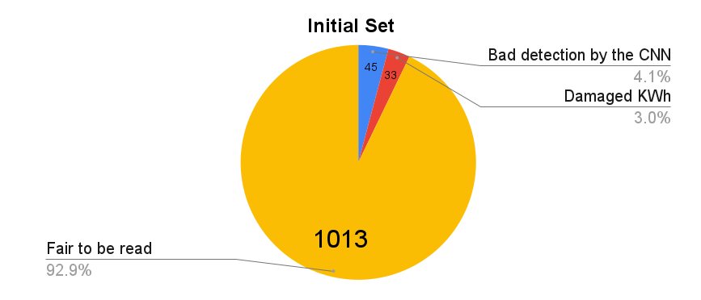
The Results
Notes:
The results were appended to a csv file and corrected one by one to derive the accuracy. The initial set was a 1091 images. Among these 1091 images, 45 were not cropped properly by the convolutional neural network which can be seen here colored in blue. Next to it we can see the red section of the pie chart with the number 33, these are the damaged images, like if an image is blurry or too dark that even a human being cannot read. These two sets were removed from the initial set in-order to have a good assumption of the final accuracy.
The number of images left to be read is 1013.

Slide 23
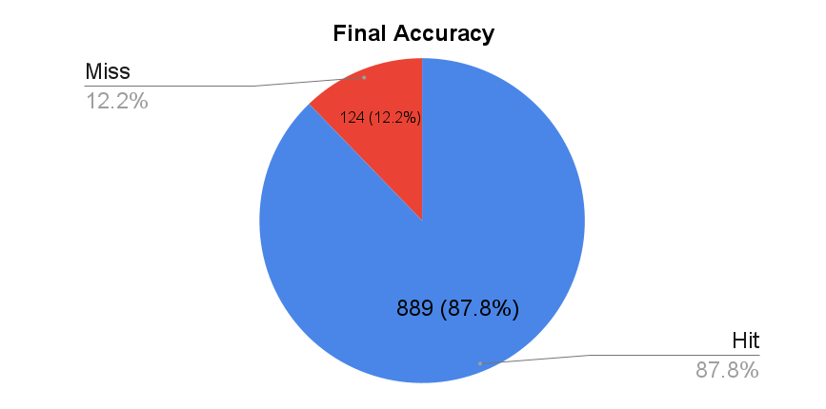
The results
Notes:
Looking at this pie chart we can see that among the 1013 images we had 889 hits, which means the 6 digits was extracted correctly. Therefore, we have achieved a final accuracy of 87.8%

Slide 24
Next Step
Create a mobile application
Each user has its credentials
Map integration inside the application
Connection to the database
Catch any mistake that happens
Show on the map if any watt-hour meter was missed
Notes:
Moving further with this project.
Create a mobile application: which will make it easier to scan each image alone
Each user has its credentials: Each worker can only see the households he or she is responsible of
Map integration inside the application: each scanned meter will be seen on the map according to its location
Connection to the database: Will provide the managers to track their worker work progress
Catch any mistake that happens: Moreover, connecting to the database, will help identify if any user has consumed more or less than the usual based on the previous consumptions
Show on the map if any watt-hour meter was missed: At the end of each month, the worker can filter the meters that were not scanned by him to avoid any mistakes.

